Slide 1
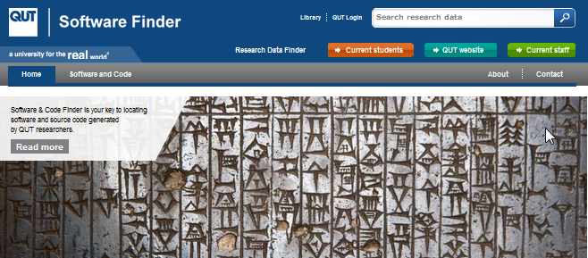
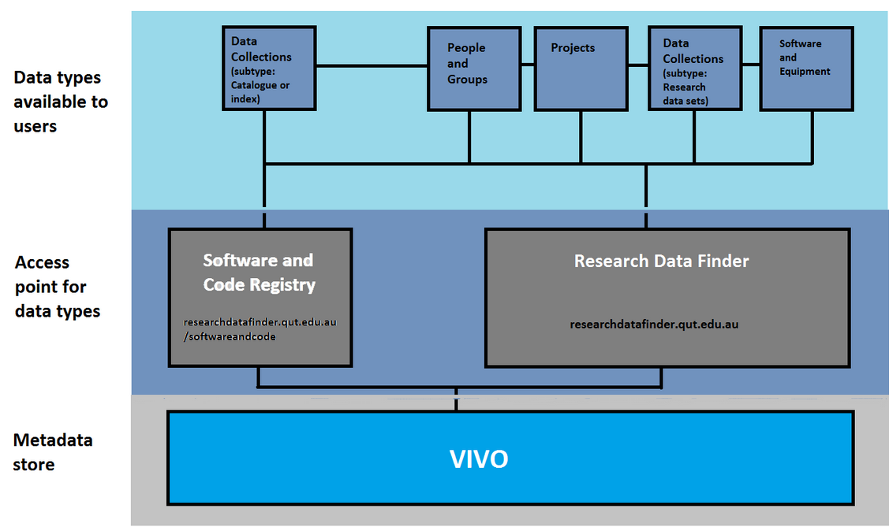
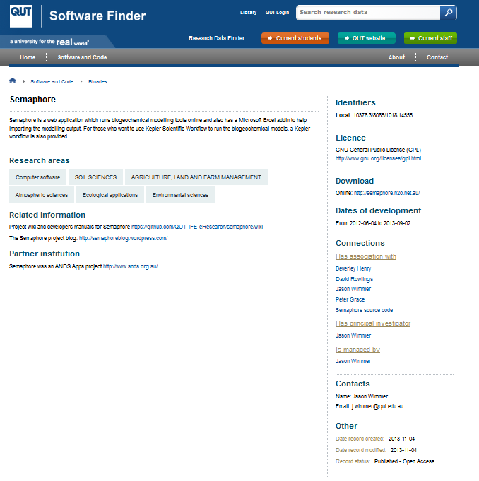
Where is the software?
Building a Metadata Repository for Software and Code Generated by QUT Researchers
Paula Callan and Philippa Broadley
Queensland University of Technology, Brisbane Australia
Contact: p.callan@qut.edu.au
About QUT
QUT has an applied emphasis in its research and, while based in Brisbane, Australia, the university has a global outlook. In 2013, student enrolment was approximately 45,000 which included over 2,600 HDR (PhD and Masters by Research) students and a similar number of academic staff.
What is QUT Software Finder?
QUT Software Finder is a searchable repository of metadata describing software and source code, which has been created as a result of QUT research activities. It was launched in December 2013.
https://researchdatafinder.qut.edu.au/scf
The registry was designed to aid the discovery and visibility of QUT research outputs and encourage sharing and re-use of code and software throughout the research community, both nationally and internationally. The repository platform used is VIVO (an open source product initially developed at Cornell University).
QUT Software Finder records that describe software or code are connected to information about researchers involved, the research groups, related publications and related projects. Links to where the software or code can be accessed from are also provided alongside licencing and re-use information.
Why QUT implemented a metadata repository for software and code
To complement the university’s metadata repository for research datasets ; QUT Research Data Finder. https://researchdatafinder.qut.edu.au/
To keep track of QUT research outputs in the form of software and code.
The repository was requested by QUT researchers in electrical engineering and computer science.
The architecture
QUT Research Data Finder
Objectives
To build a searchable registry of software outputs from QUT research activities with the following features:
Branded landing page
Searchable interface
Links to code/software location
Descriptions of the software/code and linkages with collections, parties and activities where they exist
Automated harvest to Research Data Australia
Linkages between the registry and existing QUT data stores (QUT ePrints, eStore, Research Data Finder
License definitions
Link to manuals stored on Github
Licence information
Key benefits
The metadata in QUT Software Finder is exposed to a wider research audience through selected external harvesters, including:
The Australian National Data Service which outputs the metadata via its discovery service, Research Data Australia http://researchdata.ands.org.au/
and
The National Library of Australia which outputs the metadata via its portal, Trove http://trove.nla.gov.au/people?q
Link to download location
Contact details
Authors:
Paula Callan, Scholarly Communications Librarian, QUT Library
Philippa Broadley, Research Data Librarian, QUT Library
This work is licensed under a Creative Commons Attribution 3.0 Australia Licence.

